Slide 1
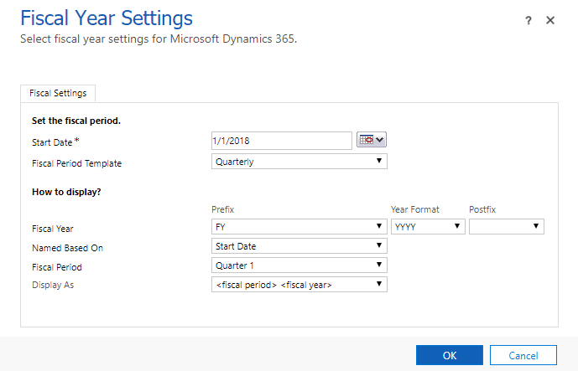

Slide 2
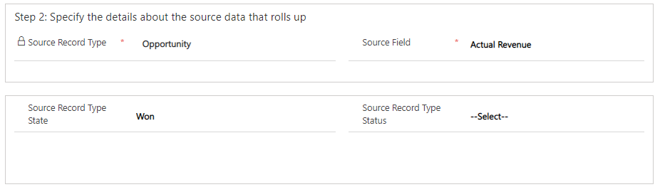

Slide 3
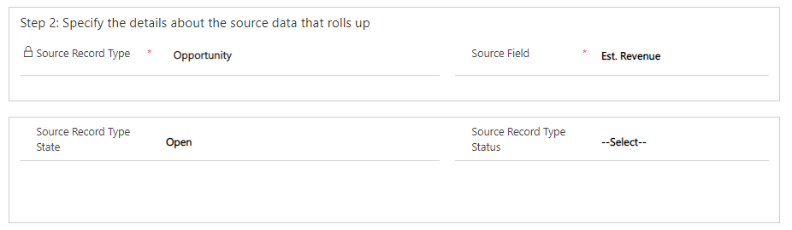

Slide 4
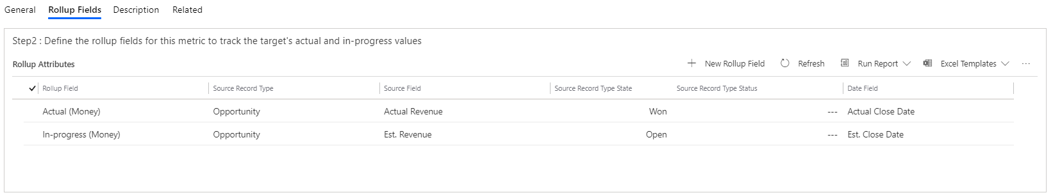

Slide 5
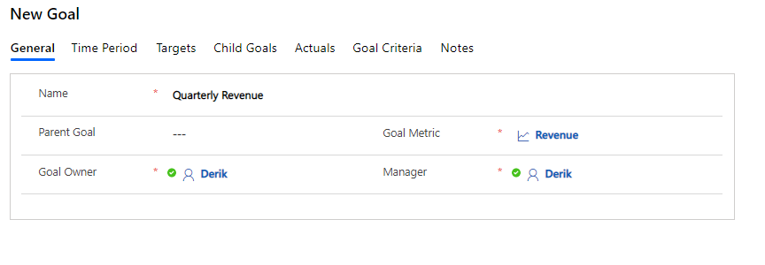

Slide 6
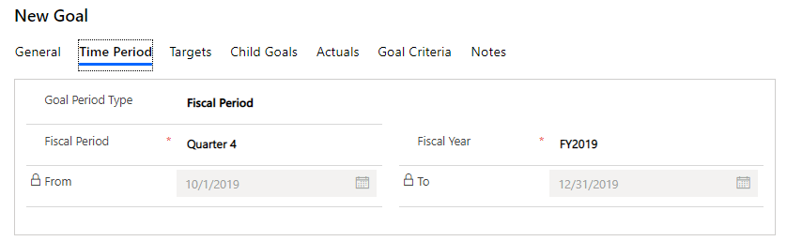

Slide 7
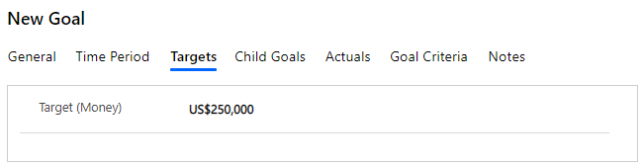

Slide 8
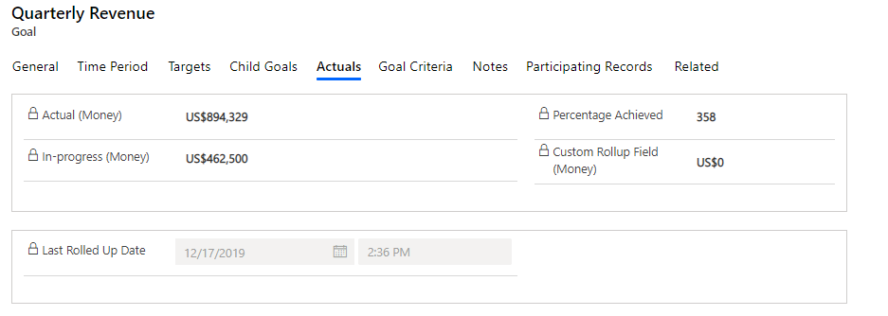

Slide 9
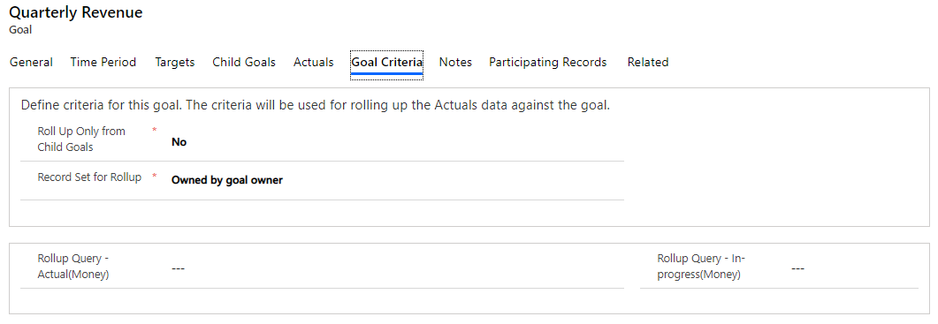

Slide 10
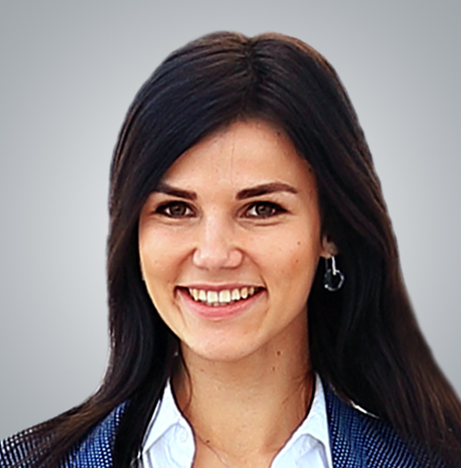
Suzanne
David
Ryan
Goal: $500,000
Actual: $250,000
Goal: $500,000
Actual: $150,000
Goal: $500,000
Actual: $300,000
Linda
Goal: $1,500,000
Actual: $700,000

Slide 11
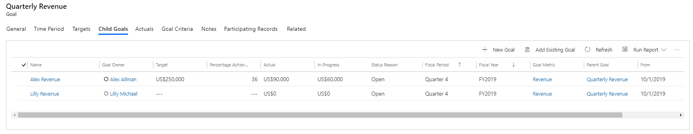
New child goals can be created directly from the parent, or existing goals can be added as children.
Individual Goal progress can be seen from the parent goal.

